Slide 1


Tech Mahindra’s DevOps
Assessment Report
Sep 2016

Slide 2
Agenda
Assessment Summary
Current State Overview
Improvement Areas
Proposed Approach & Plan
Phase 1 – Scope & Implementation Plan
Next Steps

Slide 3
“We are committed to enable Speed, Efficiency and Innovation at Scotiabank Mexico by driving DevOps adoption through a mature delivery model”
Assessment Activity Summary
Understand the current as-is process , technology & tools landscape.
Interviewed ~21 SME’s from different areas in Scotiabank (~ 30 hrs).
UNDERSTAND
Performed the Gap analysis .
Identified the key improvement areas in the Application Development Life Cycle.
ANALYSIS
Provided analysis report aiding in roadmap definition of DevOps (Continuous Delivery).
Provided recommendations on the transformation initiatives to improve the delivery life.
RECOMMENDATIONS
Proposed implementation Plan
Proposed Implementation Solution
SOLUTION
Accelerate the point solution implementation
Provided Phase – 1 Implementation plan
4 Months for first set of 3 applications ITP , ScotiaCred & SEL.
Phase 1 – Scope , Plan & Timeline.
ACCELERATE
Scotiabank DevOps Champion – Mayra Ramirez
DevOps Solution Architect – Gnanaguru Raja
Project Manager– Cecilia Gutierrez
Interpreter – Edwin Sanchez

Slide 4
Current State: Application and Technology Landscape Overview
CATEGORY | APPLICATIONS TOTAL COUNT | TECHNOLOGIES | APPROXIMATE TECHNOLOGY BASED APPLICATION COUNT | ENVIRONMENT MODEL | DIFFERENT ENVIRONMENTS
Day By Day - Production env. | ~185 | Mainframe, Tandem, Java, Visual basic , Classic ASP , .Net , Oracle, DB2, Sybase,Informix, SQL Server | ASP, VB , VC++ & .Net = ~107 Java = ~39 Mainframe = ~25 Unknown = ~14 | Data Center | IST / Dev , QAT & Production
ScotiaPro- Non Production env. | ~101 | AS 400, Tandem, Java, Visual basic , Classic ASP , .NET , Oracle, DB2, Sybase, Informix, SQL Server |  | Data Center | Dev , QAT , DryRun & Production
Release Model %
95 % - Waterfall [2 to 6 Months Release Cycle].
5 % - Agile [1 week to 3 week Sprints Cycle].
Average No. Of Releases
TEAM NAME | TEAM SIZE | NO.OF APPLICATIONS | ACTIVITY DETAILS | AUTOMATION PERCENTAGE | REMARKS
Information Security | 3 | 150 | Source Code Management User Access Control Jobs configurations for Build & Deployment automation | Build Automation - 55 % Non Production Deployment Automation - 55 % | All the Build & Deployment Jobs are configured in Dimensions tool for the following Environment IST / Dev, QAT & Production. Development Team Provides the Build & Deployment Scripts.
Code Control | 5 |  | Handling Code Merge Issues, Code Review Review the Static Security & Vulnerability reports and Provide QAT approval. |  | Day by Day - Manual Scotia Pro - Aldon tools are used
Testing Team | 50 | 149 | Test Management | 4 % | Test automation Started only last 6 months and 5 applications are automated.
Environment Management | 11 | 30 | Non Production Environment Deployment & Configuration Management Provides the Test data for testing | No Or Very Minimal | Manual Activities . Remaining applications are handled by application Development teams.
Monitoring | 5 | 200 | Application, Infrastructure, Database, Network , etc. Monitoring | 80 % | Infrastructure - 100 % , Database - 100 % & Application - 16 %
Application Support | 15 | 200 | Handle Only Production Severity 1 issues |  | IBM Maximo Tool for tracking Production issues & Change management
Solution Factory | 30 | 200 | Handle Production Severity 2 & 3 issues Involves minor production application changes [Low Complex] |  | IBM Maximo Tool for tracking Production issues & Change management
~2514 - 1 Year
~126 - 1 Month
~20 - 1 Week
Includes Application changes, Production Incidents & Problems and Infrastructure changes.
Production Issues Summary [Average]
Severity 1 Issues
~12 - 1 Month
Severity 2 & 3 Issues
~35 - 1 Month

Slide 5
Current State : Key Process Areas

Slide 6
Key Strengths
Scotia Strategic Directions
Vision
Scotia Leadership’s vision on DevOps and adopting a pragmatic approach
People
Excellent technology skills
Scotia Teams are adaptive to the idea of DevOps
Process
Certain processes and standards are defined. This covers Information Security, Change Management, Environment provisioning & Deployment readiness and Monitoring.
Multi-Vendor Environment.
Tools & Automation
Strong Source Code management, Package, Deployment management in Endevor for Mainframe systems.
Strategic investments in tools covering Security testing, Test management, Defect management & Change management and Monitoring.
Functional & Non Functional , UAT Defects are raised in HP ALM
Initiated few projects for Epics, stories and tasks are created in JIRA before development team start coding
Documents maintained in PWA [SharePoint]
55 % Automated build and deployment already in place using Dimensions
80 % Strong Monitoring system in place [Application, Infrastructure, Database, Network , etc. ]
Migration
Waterfall model to Agile & DevOps
Mainframe to AS 400
Datacenter Model [Non Production Env] to Cloud
All AIX OS to Unix & Linux
IBM Maximo to ServiceNow [In progress]
Implementation
Implement the DevOps
Implement the Automation
Enable the Mobile Testing
Training
Training on Agile & DevOps

Slide 7
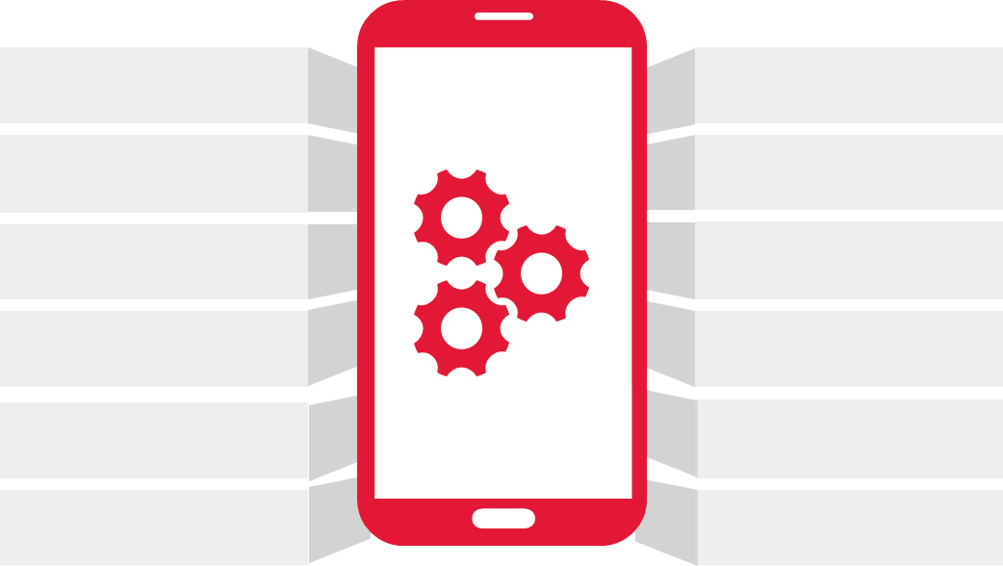

Voice of SMEs : Current Issues
Lack of automation in SDLC
Dependency with People
Code quality check not automated
Reports are generated manually in Excel
Test data not adequate
Regression test cases not updated
Unit testing is not automated
Lack of Environments
Lack of test automation
Environments Provisioning takes 8 to 10 weeks time
Dev, QA & UAT combined together
Requirements are not clear

Slide 8
Key Observations
PEOPLE
PROCESS
TOOLS & AUTOMATION
Capability:
Gaps in DevOps skills
Dependency:
Dependency on key resources is high resulting in bottlenecks and huge business risk in case key resources are not available.
Roles :
Some of the Team roles are not well defined.
Release manager role is not defined
Lateral constructs :
TPR review board is not effective. Ex: Multiple reviews and lead into Performance issues
Knowledge management is not observed
Information Security team is not evident in all projects
Definition:
Project teams are using different tools internally and processes – Not standardized.
95% projects are follows waterfall model and requirements are manually maintained in Excel
Effectiveness:
Processes are not predictable
The Requirements Documents aren't accessible to all the stakeholders
Defect leakage to production is around
35 to 40 Severity 1,2 & 3 for every month.
Inadequate Coding standards; Ex: Code reviews only the developer comment section and Code review comments are not captured; Unit testing lacks rigor
Lack of Test Data Management Process
Measurements:
Lack of end to end traceability
Tools Availability:
No Tools available for unit testing & Code Analysis
Scripts based Deployment and Deployment Jobs are configured in Dimensions.
No Tools available for environment automation & Configuration management
No Separate Tool for Binary Repository.
Automation:
Currently 5 application are automated out of 171 applications
ANT Scripts & MS Build are configured in Dimensions for 55% applications to perform the build automations [Partial].
Scripts based deployment and Scripts are configured in Dimensions for 55% applications to perform the Deployment automations [Partial].
Inadequate automation on various infra activities like database backup, error logs, running scripts,
Environment provisioning is not automated or on demand
Integration:
Tools are not integrated except Monitoring area.
Single pane view of end to end application status is not available

Slide 9
Current State:
Recommended Tools Overview
Future State:
Process Area | Tools Used/ Recommended | Status
Agile Planning & Requirement Management | Jira
Collaboration | Confluence
Developer IDE | Eclipse , Visual Studio
Unit Testing | Junit , Nunit
Code Coverage | JACOCO, FX Cops
Code Review | Gerrit
Static Code Analysis | SonarQube
Source Code Management | Bitbucket
Build Process | Maven, MS Build
Security Testing | HP Fortify & WebInspect
Orchestration | Jenkins
Artifacts Repository | Nexus / Artifactory
Deployment Automation | uRelease, uUdeploy, XebiaLab
Environment Provisioning & Configuration management | Puppet
Test Management | HP ALM
Defect Management | HP ALM
Test Automation | HP UFT , HP Loadrunner
 | Selenium
Service Virtualization | CA SV
Test Data Management | CA TDM
Applications Monitoring | CA APM
Automatic Alerts & Notifications | Email
Reports and Dashboards | Jira & Confluence
Tools already used
Recommended Tools

Slide 10
Key Improvement Areas
AREA | PROCESS | CURRENT STATE OBSERVATIONS | IMPROVEMENT AREAS | TOOLS
Requirement Gathering & Planning | Requirement Management | 95 % Waterfall and 5 % Agile followed. Requirements captured in MS Word Planning is done using MS Excel The architecture for the solution is decided and approved in TPR Committee Design documents related to various components are maintained in SharePoint and are reviewed by IS / IST & TPR. Capacity Planning is maintained in excel sheet. Collaboration & visibility needs to improve between teams. | Standardize requirement and planning process across all applications Use Epics, User Stories and Tasks Customer sign off on requirement analysis Requirements to be maintained in Single tool rather than maintaining the Different Excel. Documents to be places in one place and can be accessed by different users based on roles Association of documents with requirements Enable the Collaboration n & Visibility between teams. | Tools Already in Place Atlassian Jira Suggested Tools Confluence
 | Program/Project Management
 | Sprint Planning
Information Security & Code Control | Source Code Management | Inadequate Source code management process in Dimensions [VB,ASP,.NET & JAVA] Ex : No Feature branches and Main branch concepts Manual Code Review Merging is done manually Developers are keeping the modified code in their local machine and not allowed to use SCM. Technical lead collect the updated source code and upload into SCM. Test case coverage is not done Manual Unit testing and result are captured in MS Word Unit Testing Defects are tracked in Excel or Email Static code analysis is not done Build Process used ANT , MS Build and configured in Dimensions. Security Testing has been implemented with HP Fortify & WebInspect. Artifacts are stored in shared drive. | Follow Continuous Integration and Delivery practices Orchestration Tool Standardize source code management with Feature branches and Main branch concepts Automated Static code analysis Automated Code review, Code coverage and automated unit testing Artifact management Enable the Tools integration and Feedback mechanism to Jira & Confluence. | Suggested Tools BitBucket Unit Testing with Junit & Nunit Code Coverage – Java –Jacoco & .Net – FX Cops Code Review - Atlassian Crucible / Gerrit Static Code Analysis – Sonarqube Build Process with Maven & MS build. Artifacts Repository –Artifactory Continuous Integration Orchestration – Jenkins
 | Code Review & Code Merge
 | Unit Testing & Code Coverage
 | Static Code Analysis
 | Security Testing
 | Build Process
 | Artifacts Repository

Slide 11
Key Improvement Areas
AREA | PROCESS | CURRENT STATE OBSERVATIONS | IMPROVEMENT AREAS | TOOLS
Environment management & Deployment | Configuration Management | Some applications deployment Scripts are configured in Dimensions Some applications are performed manual deployments & Manual Backup[Production & Non Production]. Production deployment handled by vendor team [IBM]. All deployment related issues needs to manually verify and it’s not tracked . All the backup ‘s are maintained in the same server. Server & Application related configurations are handled manually. Environments are in Data center Model Unused Environments are not shutdown Environment Provisioning is the very lengthy process and Vendor team [IBM] is taking 4 to 8 weeks to provide the new Environment. Inadequate infrastructure Inventory Application Installation steps created in the MS Excel. | Release and deployment automation Automated environment provisioning and configuration management Automated Workflow based deployment with backup & Rollback mechanism Versioned build in Binary management Enable the automatic Defect notification Enable the automatic feedback to Jira & Confluence. | Suggested Tools Jenkins Rundeck Chef
 | Deployment
 | Environment Provisioning
 | Release Planning
Testing | Test Management | Testing is established as independent function in the last 6 months. Only 5 applications are automated out of 171 application with HP UFT & HP Loadrunner. Test Documents like Test Plan , Test Strategy is maintained in HP ALM Different Types of testing are carried out manually like : Smoke test , Functional , Non-Functional , Regression & UAT Testing for a particular feature Majority of the defects identified are due to lack of regression suite Test Data is not refreshed with production data and testing is done on basis of data shared by the onsite team Testing End- end scenario is not fully completed due to lack of test data & environment unavailability HP ALM is used for Test Case repository and are manually linked with requirements . HP ALM is used for Defects logging & management No Test Data repository and Test Data Management | Regression suite needs to be strengthen and needs to be update so as to reduce the number of defects and the turn around time for these fixes Automating the test execution and increase the performance testing % Test Data need to be refreshed with Non production Environment/production data for every sprint or major release Well defined Test Suite for each sprints should be maintained in HP ALM Enable the automatic defect creation and association with Test cases & Requirements. Custom Reports and dashboards needs to be built to track the defect fixes and test execution status Implement the Service Virtualization | Tools Already in Place HP ALM HP UFT HP LoadRunner Suggested Tools CA DevTest CA Test Data Manager
 | Test Automation
 | Test Data Management
 | Defect Management
 | Service Virtualization

Slide 12
Key Improvement Areas
AREA | PROCESS | CURRENT STATE OBSERVATIONS | IMPROVEMENT AREAS | TOOLS
Monitoring | Application | 100 % monitoring automation in place for the Infrastructure, Database & Hardware for the Production Environment Application monitoring automated for 40 applications out of 171 in production. Proactive Information's & Warnings are automatically captured and manually validated. Reactive Critical & Fatal are automatically captured and automatically create the defects in IBM Maximo for the application support team. Most of the Monitoring tools are integrated and CA SOI generated enrich dashboard. | Implement the Application monitoring for all the Production application Implement the Monitoring automation on Non production Environments Implement the Inventory management for Monitoring | Tools already in Place CA APM IBM TIVOLI Foglight CA ADA CA Wily CA Vantage CA DB2 insight CA Sysview Invision IBM system director CA SOI
 | Database
 | Infrastructure, Hardware
 | Issues management and Dashboard & Reports
Change Management & Application Production support | Change management | Release Plan is captured in IBM Maximo’s ticket, when the steps in the Release Plan are more than 30, the Release Plan is capture in MS Excel and attached to IBM Maximo’s ticket. The impact of the Release Plan is analyzed and approved in Changes committee & Release committee. Production support handled by vendor team [IBM]. Before release plan execution, vendor team [IBM] executed an assessment to validated all the information. IBM Maximo’s ticket can be modify at any time before the ticket is closed, even after , vendor team [IBM] executed an assessment . | Standardize Release Plan process across all applications. Custom Reports and dashboards needs to be built to track the changes execution status. | Tools already in Place IBM Maximo Suggested Tool ServiceNow Scotia already in Migration plan IBM Maximo to ServiceNow
 | Ops Readiness
 | Deployment Readiness
 | End User Training

Slide 13
Phased evolution to a mature DevOps environment and a CoE de-risking change
Proposed Approach
High
Value Enhancing Organization Asset
MATURITY
Low
Phase 1 |  | Phase 2 | Phase 3 / 4
Pilot for 3 applications |  | ~30 additional applications | ~80 additional applications
Continuous Planning Requirement management Release planning Continuous Integration Source code management Code quality Build automation | Continuous Testing Test automation Test data management Service virtualization | Continuous deployment Non Production Deployment automation Automatic environment provisioning Configuration management | Continuous improvements Mature DevOps CoE Continuous feedback Integrated platform Production Deployment automation Continuous monitoring
4 months |  | 4 months | 4 + 4 months

Slide 14
Proposed Plan (Phase-wise)

Slide 15
Timeline (Phase-wise)
DevOps Implementation for Scotia
Sr. No | Activities | Team | M1 | M2 | M3 | M4 | M5 | M6 | M7 | M8 | M9 | M10 | M11 | M12 | M13 | M14 | M15 | M16
 | Phase-1 Implementation
1 | Continuous Planning & Integration | TechM
2 | Continuous Testing | TechM
3 | On boarding 3 applications | TechM
 | Phase-2 Implementation
4 | Implement the Continuous Deployment for initial 3 applications | TechM
5 | On boarding another ~40 applications on Phase-1 Implementation | TechM
 | Phase-3 Implementation
6 | Implement the Production Deployment automation for initial 3 applications | TechM
7 | Implement the Application Monitoring for initial 3 applications | TechM
8 | On boarding another ~50 applications on Phase-1 & 2 Implementation | TechM
 | Phase-4 Implementation
9 | Enable the Continuous Feedback | TechM
10 | Build the DevOps CoE | TechM
11 | Enable the Dashboard & Reports | TechM
12 | On boarding another ~51 applications | TechM

Slide 16
DevOps solution for Scotiabank
Continuous Planning
Continuous Integration
Continuous Testing
Continuous Deployment
Continuous Monitoring
Continuous Delivery Automation
Integrated Platform (Jira & Confluence)
Integrated Platform
Project Planning
Epics & User Stories
Issue management
User Management
Administration
Reports and Dashboards
Orchestration (Jenkins)
Integration Engine
Requirements Gathering (JIRA)
SCM (BitBucket)
Functional Test
(HP UFT /Selenium)
Deployment Automation – Non Production Env (uRelease, uUdeploy, XebiaLab )
Applications Monitoring
(CA APM)
Phase 1
Project & Release Planning (JIRA)
Code Review (Gerrit)
Performance Test
(HP Loadrunner)
Phase 2
Environment Provisioning & Configuration Management (Puppet)
Phase 3 & 4
Team Collaboration & Document Repo. (Confluence)
Build Process
(Maven/MS Build)
Regression Test Suite (HP UFT/ Selenium)
Deployment Automation –Production Env (uRelease, uUdeploy, XebiaLab )`
Functional Platform
Unit Testing (Junit/Nunit)
Test Data Management
Code Coverage
(JACOCO/FX Cops)
Service Virtualization
(CA DevTest)
Static Code Analysis
(SonarQube)
Defect Management
(HP ALM / Jira)
Security Testing
(HP Fortify & WebInspect)
Binary Management
(Nexus)

Slide 17






Centralized system End State View
Enable multiple suppliers to work with common platform and processes. Access Control and authentication mechanisms enforces security controls.
DevOps Platform
Plans
TechM
Code
Tests
Client IT
Defects
Supplier-1
Docs
Releases
Operational Metrics
Known Error DB
Supplier-2

Slide 18


Implementation Approach: Governance & Communication Plan
Executive Sponsor (Scotia )
Scotia Leadership Team
TechM Leadership Team
STEERING COMMITTEE
E-Banking
Finance
Shared Services
Cash Management
Bank Deposits/Investments
IT
Core Team (consists of representatives from all application domains
Release
Managers
Delivery
Leads
Application
SME
Architects
Project
Managers
Demand
Mgmt.
Operations
DevOps Communications / Governance / APP On Boarding
Centralized Program Management Office (TechM)
TechM DevOps
Program Manager
Scotia DevOps Program Manager
Program Manager
Program Management
Process Management
Metrics Definition
DevOps Coaches
Infrastructure &
Tools COE
DevOps Trainings
Reporting
Resource Training
Tools & Process Trainings
Delivery Assurance
Technical Support
Joint CENTER OF EXCELLENCE (CoE)s

Slide 19

DevOps Team Composition
DevOps team provides service continuity for the engagement
Primary responsibilities (DevOps Team)
Strong knowledge on the Agile & DevOps
Very good understanding of CI and best practices and processes
Support project teams to adopt best practices; guide the teams in implementing CI-CD processes in projects
Support project teams in automating the build and CI processes
Support Testing teams on adopting Test Automation Frameworks (based on pre-agreed test automation tools)
Support Testing and development teams on adopting Service Virtualization techniques
Very good understanding of Environment Configuration and best practices. Strong Skills in Puppet
Develop Puppet base and best practices
Support project teams to adopt best practices in application deployments
Support project teams in automating the Deployment process
Knowledge management, Documentation, Training
Knowledge transfer and Transition
Process Improvements
DEVOPS TEAM
Team Roles:
DevOps Solution Architect
Agile Coach
Continuous Integration SME
DevOps Engineers
SME/Lead (Deployment & Environment)
Environment Engineers
Test Automation SME
Test Virtualization SME (SV)
Proposed team for Phase 1:
Agile Coach
DevOps Solution Architect
DevOps Engineer (Project 1)
DevOps Engineer (Project 2)
DevOps Engineer (Project 3)

Slide 20
Phase-1 Objective
Phase-1 Scope
Continues planning
Requirement Gathering & Release Planning with JIRA
Project Planning with JIRA
Team Collaboration with Confluence
Document Repository with Confluence
Enable the Integration to Jira & Confluence for the Traceability
3 applications [ITP , ScotiaCred & SEL] onboarding into Continuous Planning area
Existing Applications related artifacts migration into Jira & Confluence
Implementing the Dashboards / Reports in Jira & Confluence
Understanding the current as-is process , technology & tools landscape for the following applications ITP , ScotiaCred & SEL.
Identify the key challenges in the Development Life Cycle.
Define the use case for the Phase 1 - Implementation.
Finalize the Phase – 1 Scope & Timeline, which enables the DevOps transformation initiatives to improve the delivery life cycle
Continues Integration
SCM - future branch & main branch structure with BitBucket
SCM Migration from Serena Dimensions to BitBucket
Applications Source code needs configuring from SCM to Developer IDE [Ex: Eclipse / Visual Studio]
Creating Automated build with Maven / MS Build / ANT
Enabling automated Code review process with Gerrit
Automated unit testing with Junit / Nunit
Automated Static code analysis with Sonar Qube
Binary repository with Nexus
Security Testing - HP Fortify & WebInspect & needs to include in the CI pipeline
Orchestration with Jenkins and creating Continuous Integration pipeline
3 applications [ITP , ScotiaCred & SEL] onboarding into Continuous Integration area
Implementing Test automation into CI pipeline

Slide 21
















Phase – 1 : Proposed Solution Workflow
Defect Management
(Jira)
Test Management & Defect Management
(HP ALM)
Fail
Fail
Deployment & testing failures
Fail
Fail
Fail
Promote Environments
Fail
Dev
QA
Quality
Gate 1
UAT
Pass
Collaboration
Quality
Gate 5
Quality
Gate 2
Quality
Gate 3
Quality
Gate 4
Code Review
Pass
Pass
Binary
Files
Pass
Pass
Security
Testing
Code Quality
Repository Manager
Quality
Gate 6
Quality
Gate 7
Dev Team
Automated Build
Code Coverage & Unit Testing
Requirement Gathering & Planning
Version
Control
Smoke & Functional
Testing
(HP UFT)
Performance Testing
(HP Loadrunner)
Service Virtualization
(CA DevTest)
Code Check in
Jenkins Job
- Trigger
Jenkins Job
- Trigger
Jenkins Job
- Trigger
Jenkins Job
- Trigger
Jenkins Job
- Trigger
Jenkins Job
- Trigger
Orchestration with Jenkins
Automated Feedback Flow (Confluence & Jira) Dashboards & Reports

Slide 22
Scotiabank Mexico – Phase 1 Effort & Commercials
DevOps Phase-1 Implementation for Scotia |  |  | CI Platform Building |  |  |  |  |  |  |  |  |  |  |  | 3 Applications Onboarding
Sr. No | Activities | Team | W1 | W2 | W3 | W4 | W5 | W6 | W7 | W8 | W9 | W10 | W11 | W12 | W13 | W14 | W15 | W16
1 | Providing infrastructure and required access | Scotia
2 | Environment setup & Software installation @ Scotia Network | TechM
3 | Software Configuration for Platform | TechM
4 | Implementing JIRA & enable the Agile process | TechM
5 | Implementing Confluence & enable the Collaboration | TechM
6 | Enable the automation, Creating adaptors to enable the integration. For Ex. Junit Testing status to Jira & SonarQube to Jira | TechM
7 | Enable the automation, Customize existing readily available adaptors. For Ex. Confluence & Jira , Jenkins to Jira & BitBucket to Jira | TechM
8 | Build the CI platform | TechM
9 | Onboard the initial 3 applications into CI pipeline. | TechM
10 | Integrate the Test automation into CI pipeline | TechM
11 | Customize the Reports | TechM
12 | Access mechanism setup | TechM
13 | Test and validate the CI platform | TechM & Scotia
14 | Go Live | TechM
`
Role | M1 | M2 | M3 | M4 | Cost
 |  |  |  |  | (Indicative) in $ USD
Continuous Planning & Integration Automation
Onsite |  |  |  |  | TBD
DevOps Solution Architect | 1 | 1 | 1 | 1
Continuous Integration SME | 2 | 2 | 2 | 2
Interpreter | 1 | 1 | 1 | 1
Offshore
DevOps Engineer’s | 2 | 2 | 2 | 2
Agile Process
Agile Coach | 1 | 1 | 1 | 1 | TBD
Grand Total |  |  |  |  | TBD
*Does not include tool license, hardware and infrastructure costs

Slide 23
Assumption / Dependencies
Scotia to identify a single point of contact for TechM to facilitate the implementation
Scotia to provide infrastructure & required software licenses to TechM
Scotia to provide required build, test, & deployment script for the particular project
Scotia to review and sign off the Phase 1 - CI platform implementation plans and deliverables
Scotia to provide the acceptance sign off for the Phase 1 - CI platform implementation
Provide required access to TechM teams to carry out the Phase 1 - CI platform implementation
Communication on Phase 1 – CI platform implementation updates to stakeholders
Scotia will provide the application details , which needs to implement the solution.
Scotia will provide the current release planning details.

Slide 24
Review and Feedback on the Assessment Report
Commercial Proposal
Next Steps

Slide 25
Appendix

Slide 26
Assessment Approach
Objective:
Identify the key improvement areas in the Application Development Life Cycle and provide recommendations on the transformation initiatives to improve the delivery life cycle
Provide analysis report aiding in roadmap definition of DevOps (Continuous Delivery)
Methodology:
Predefined questionnaires to measure the current state
Interview the key stakeholders across the IT landscape
Understand current process being followed and identify process/system owners
Understand application landscape and Current (As-Is) organizational structure, functions, IT infrastructure for the organization in scope
Identify the focus area (planning, Build, delivery, testing, deployment, Tools and monitoring) that needs immediate attention
Review the workflows with all stakeholders
TechM's role:
Collect As-Is details of the organization’s processes and practices
Identify process improvements
Consolidate findings and report existing process strengths, gaps and areas for improvement
Present the Assessment Report
Scotia’srole:
Identify a Single Point of Contact (SPoC)
Coordinate the provision of access to the scope related process documents/artifacts/tools
Ensure availability of the identified stakeholders
Sign-off on the Assessment report
Benefits:
Focuses on capturing the existing practices of the organization in scope of DevOps
Detailed report consisting of gaps and Phase-1 implementation plan along with Scotiabank Tools Set
Helps in overall implementation planning and implementation of DevOps

Slide 27
Scope Of Engagement
Current State Assessment by following functional areas
Application and technology landscape
Tools landscape
Development processes
Deployment and Release Management
Environment Management and provisioning
Projects (In-Flight and Planned)
Testing and Test Automation
Metrics
Reports and visibility to management
Phase 1 Focus Systems
ScotiaCred
Interactive Teller Platform
ScotiaWeb

Slide 28
Meetings
PARTICIPANT | DEPARTMENT | AREA
Susana Porres | DPS & Scrum Team | Planning and Requirement Management
Víctor Sánchez | Solution Architect | Application Landscape and architecture
Juan Carlos | Solution Architect | Application Landscape and architecture
Saúl Villagómez | Application Support & Solution Factory | Production Support
Jorge Castro | IST | Development Processes
Rene Rodríguez | IST | Development Proceses
Beatriz Fuentes | IST | Application Team – SEL
Norma Hernández | IST | Application Team – ScotiaCred
Julio Cesar Hernández | IST | Application Team – ITP
Rogelio Rangel | Information Security [Static Code Analysis] | Development Processes
Ignacio Quintanar | Information Security [Change Control] | Source Code Management [Production Env]
Fernando Trejo | Information Security [Change Control] | Source Code Management [Production Env]
Gustavo Castellano | Code Control | Source Code Management [Non -Production Env]
Jesús Sánchez Mujica | Code Control | Source Code Management [Non -Production Env]
Daniel Partida | Quality Assurance & Quality Control | Testing
Alejandro Gasca | Quality Assurance & Quality Control | Testing
Salvador Sierra | Non Production Environment Management | Environment Management and provisioning
Rodrigo Campos | Non Production Environment Management | Environment Management and provisioning
Mayra Ramirez | Infrastructure | Environment Management and provisioning
Rosa María Alfaro | Change Management | Operation
Eduardo Mactotela | Operation | Operation
Héctor Sanchez | Monitoring | Monitoring

Slide 29
Interviews – Completed
S.Num | Scotia Team | TechM Team | Date / Time | 9:00 AM | 10:00 AM | 11:00 AM | 12:00 PM | 1:00 PM |  | 2:00 PM |  | 3:00 PM | 4:00 PM | 5:00 PM | 6:00 PM
 |  |  |  | 9 to 10 | 10 to 11 | 11 to 12 | 12 to 1 | 1 to 2 |  | 2 to 3 |  | 3 to 4 | 4 to 5 | 5 to 6 | 6 to 7
1 | Scotia Senior management | TechM DevOps Team | 22-Aug-16 |  |  | Internal TechM Review |  |  |  |  |  |  | Scotia Team is fine with Techm approach and approved to start the assessment.
2 | Scotia DevOps Spoc | TechM DevOps Team | 23-Aug-16 | No Schedules
3 | Scotia DevOps Spoc | TechM DevOps Team | 24-Aug-16 |  | Explained about DevOps & Assessment plan to Scotia Spoc |  |  |  |  |  |  |  |  | ENVIRONMENT MANAGEMENT & PROVISIONING
4 | Scotia Spoc & Team | TechM DevOps Team | 25-Aug-16 | User Cancelled | ENVIRONMENT MANAGEMENT & PROVISIONING | CONFIGURATION & BUILD MANAGEMENT, CODE REVIEWS [Mainframe] | MONITORING |  |  |  | CONFIGURATION & BUILD MANAGEMENT, CODE REVIEWS [Java, .NET, VB, ASP..Etc....]
6 |  |  | 26-Aug-16 | No Schedules
7 |  |  | 29-Aug-16 |  | Requirement Gathering & Planning |  |  |  |  |  | Scrum Team |  | Requirement Gathering & Planning | Application Support
8 |  |  | 30-Aug-16 | Requirement Gathering & Planning |  |  |  |  |  |  | Code Control [2 teams]
9 |  |  | 31-Aug-16 |  | Architecture |  | Application - SEL |  |  |  | Application - ITP
10 |  |  | 1-Sep-16 |  | Architecture |  | INFORMATION SEGURITY |  |  |  |  |  | DEVELOPMENT | Testing
11 |  |  | 2-Sep-16 | No Schedules
12 |  |  | 5-Sep-16 |  | User Cancelled | Testing | Operations |  |  |  |  | User Cancelled
13 |  |  | 6-Sep-16 |  | Operations |  |  |  |  |  |  | Application - ScotiaCred

Slide 30
Current State: Team Activity & Automation level
Team Name | Team Size | No.Of Applications Approximately | Activity Details | Automation Percentage | Remarks
Information Security | 3 | 150 | Source Code Management User Access Control Jobs configurations for Build & Deployment automation | Build Automation - 55 % Non Production Deployment Automation - 55 % | All the Build & Deployment Jobs are configured in Dimensions tool for the following Environment IST / Dev, QAT & Production. Development Team Provides the Build & Deployment Scripts.
Code Control | 5 |  | Handling Code Merge Issues, Code Review Review the Static Security & Vulnerability reports and Provide QAT approval. |  | Day by Day - Manual Scotia Pro - Aldon tools are used
Testing Team | 50 | 149 | Test Management | 4 % | Test automation Started only last 6 months and 5 applications are automated.
Environment Management | 11 | 30 | Non Production Environment Deployment & Configuration Management Provides the Test data for testing | No Or Very Minimal | Manual Activities . Remaining applications are handled by application Development teams.
Monitoring | 5 | 200 | Application, Infrastructure, Database, Network , etc. Monitoring | 80 % | Infrastructure - 100 % , Database - 100 % & Application - 16 %
Application Support | 15 | 200 | Handle Only Production Severity 1 issues |  | IBM Maximo Tool for tracking Production issues & Change management
Solution Factory | 30 | 200 | Handle Production Severity 2 & 3 issues Involves minor production application changes [Low Complex] |  | IBM Maximo Tool for tracking Production issues & Change management

Slide 31
Applications Analysis
Portfolio Owner | Patel, Sanjiv
Total No.Of Business Unit | 15
Total No.Of Applications | 185
Business units | Total No.of shared Applications
CIF, Satellites, CDs, Savings, Bank Cheques | 12
CIF, Satellites, CDs, Savings, Bank Cheques, Commercial | 1
CIF, Loans retail and Commercial | 1
CIF, Deposits, Payments, ACH, Debit Card, Credit Card, Tellers, Transfers | 14
CIF, Deposits, Loans retail and Commercial | 1
CIF, Loans retail and commercial | 19
Deposits, Payments, ACH, Debit Card, Credit Card, Tellers, Transfers | 45
GL | 2
GL, CIF, Satellites, CDs, Savings, Bank Cheques | 15
GL, CIF, Deposits, Payments, ACH, Debit Card, Credit Card, Tellers, Transfers | 1
GL, Deposits, Payments, ACH, Debit Card, Credit Card, Tellers, Transfers | 3
GL, Loans retail and Commercial | 1
GL, CIF, Deposits, Payments, ACH, Debit Card, Credit Card, Tellers, Transfers | 1
GL, CIF, Loans retail and Commercial | 1
Loans retail and commercial | 32
Satellites, CDs, Savings, Bank Cheques | 1
No Core | 26
To Remove | 9
Total | ~185
Approx. Application Count
Technology | Count
Java | 39
.Net | 7
ASP & VB | 80
VB & C | 1
VCC++ | 1
C & Tandem | 6
Unknown | 26
Mainframe | 25
Total | ~185
Application Criticality level
No.Of Applications Approximately | High | Medium | Low
~185 | ~97 | ~51 | ~37

Slide 32
Requirement Gathering & Planning – Current Process Flow

Slide 33
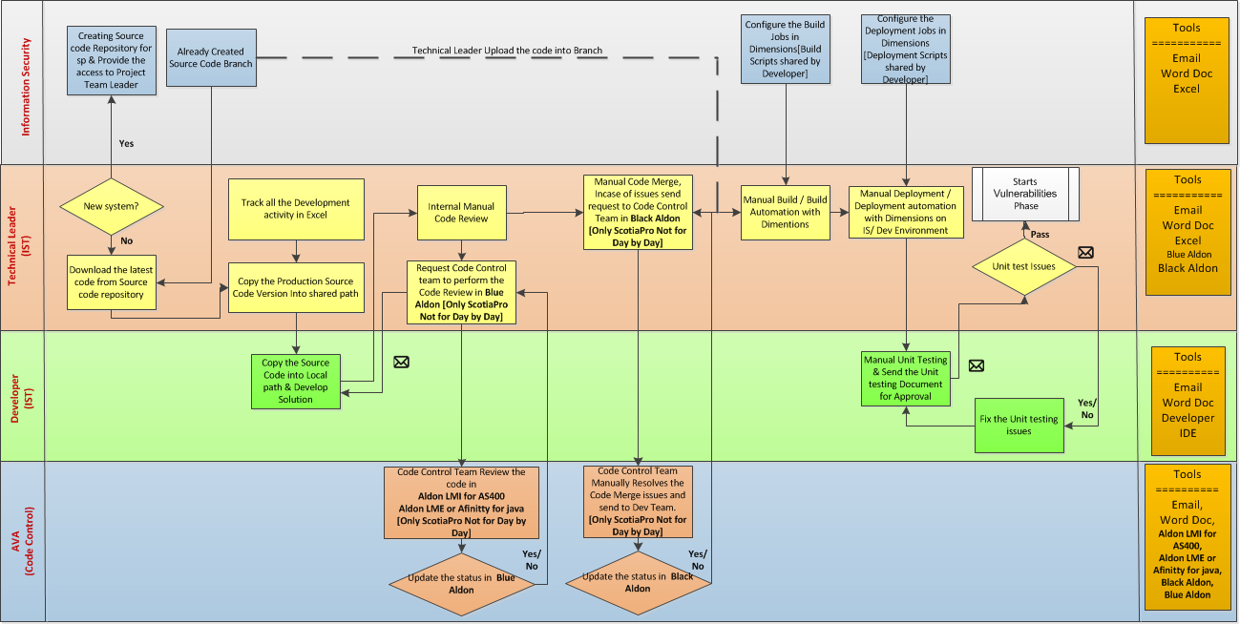
Code Development Phase– Current Process Flow

Slide 34
Vulnerability Test & QAT Deployment – Current Process Flow

Slide 35
Complete End To End Release Cycle
START
RELEASE PROCESS
Is it a New Requirement?
YES
Warranty’s Defects?
YES
Is it a New Req. for Scrum Team?
NO
Req. Gathering & Planning
Waterfall
Design
Waterfall
Development
Waterfall
Test
Waterfall
Deployment
Waterfall
Warranty Period
Waterfall
NO
Daily
stand-up
meeting
Include in Product Backlog
Sprint Planning Meeting
Sprint 1 ~ 4
Weeks
Iteration
YES
Is it a Production Incident or OT?
APPLICATION SUPPORT PROCESS
YES
YES
Solution Factory’s Resolution
Severity 2, 3 or OT?
MQC Test
END
NO
Application Supports' Resolution

Slide 36

Current State: High-level Overview – Application ITP
Technology: Java 1.7, JSF , Data Base: DB2 10.5 , Domain: Channel’s , Environments: Dev, QAT, Production [Datacenter model] and
Application Type & Server : Web application and WAS 8.5 in AIX 7 Operative System
Process Area | Tools | Not Existing | Manual | Semi Automated | Automated
Requirement gathering | MS Excel , MS Word | 1
Program/Project Management | MS Excel
Design Phase | MS Visio, IBM EA
Source Code Management | Serena Dimension, SVN
Developer IDE | Eclipse
Unit Testing | MS Word
Code Coverage | NA
Code Review | NA
Static application security & Vulnerability | HP Fortify & Web Inspector
Build Process | Serena Dimension
Binary Repository | NA [Shared Directory]
Deployment | Serena Dimension
Testing | HP ALM, HP UFT , HP LoadRunner
Defect Management | HP ALM & Aldon
Application / Server / Network Monitoring | CA APM, IBM TIVOLI , Foglight, CA ADA, CA Wily, CA Vantage, CA DB2 insight, CA Sysview, Invision, IBM system director
Test Data Management | NA
Service Virtualization | NA
Alerts & Notifications | Exchange Sever
Operations | IBM MAXIMO
Reports | Excel Sheet, MS Word, HP ALM (Defect related report) & CA SOI
Key Observations:
The development process follows waterfall model. Test preparation runs in parallel with development.
The code versions used day by day are maintained in SVN by the ITP’s team internally.
The SVN is installed in a development server.
In SVN, the ITP’s development team aren't using branches, they avoid parallel development to avoid performing the merge.
The code versions used to promote to non-production and production environments are maintained in Serena Dimensions as a part of waterfall process.
Unit testing's are performed manually, based on test cases requested to QC.
In case of defects in unitary tests, the follow-up is by mail.
The build process is semi automated performed, by ant’s script configured in Serena Dimensions to generate 3 different packages for different environments ( Dev, QAT & Production).
Every single time that build process is executed, generate 3 different packages for different environments, in case there are no issues, this version goes into production.
In some cases versions are being generated incorrectly by the semi automated build process. The deployment process is semi automated performed.

Slide 37
Current State: High-level Overview – ScotiaCred
Technology: Visual Basic 6 , Data Base: Sybase , Domain: Core Banking, Environments: 3 Development Environments
Process Area | Tools | Not Existing | Manual | Semi Automated | Automated
Requirement gathering | MS Excel , MS Word, Jira | 1
Program/Project Management | MS Excel
Design Phase | MS Visio, IBM EA
Source Code Management | Serena Dimension
Developer IDE | Visual Basic 6
Unit Testing | MS Word
Code Coverage | NA
Code Review | NA
Static application security & Vulnerability | HP Fortify & Web Inspector
Build Process | Serena Dimension
Binary Repository | NA [Shared Directory]
Deployment | Serena Dimension
Testing | HP ALM, HP UFT , HP LoadRunner
Defect Management | HP ALM & Aldon
Application / Server / Network Monitoring | CA APM, IBM TIVOLI , Foglight, CA ADA, CA Wily, CA Vantage, CA DB2 insight, CA Sysview, Invision, IBM system director
Test Data Management | NA
Service Virtualization | NA
Alerts & Notifications | Exchange Sever
Operations | IBM MAXIMO
Reports | Excel Sheet, MS Word, HP ALM (Defect related report) & CA SOI
Key Observations:
The development process follows Scrum Framework and waterfall model.
They have 4 scrum’s cells, in some cases the scrum’s cell exceed the scrum’s team size recommended.
Scrum Masters that they currently have are new and need an expert guide.
Only the technical lead has the access to Serena Dimensions.
The team avoid parallel development to avoid performing the merge.
There are 3 ScotiaCred environments; these environments meet the function of test and development environments, when the development is over, access is restricted to the development team and this is granted to the test team.
The build process is manually performed.
The deployment process is manually performed.

Slide 38
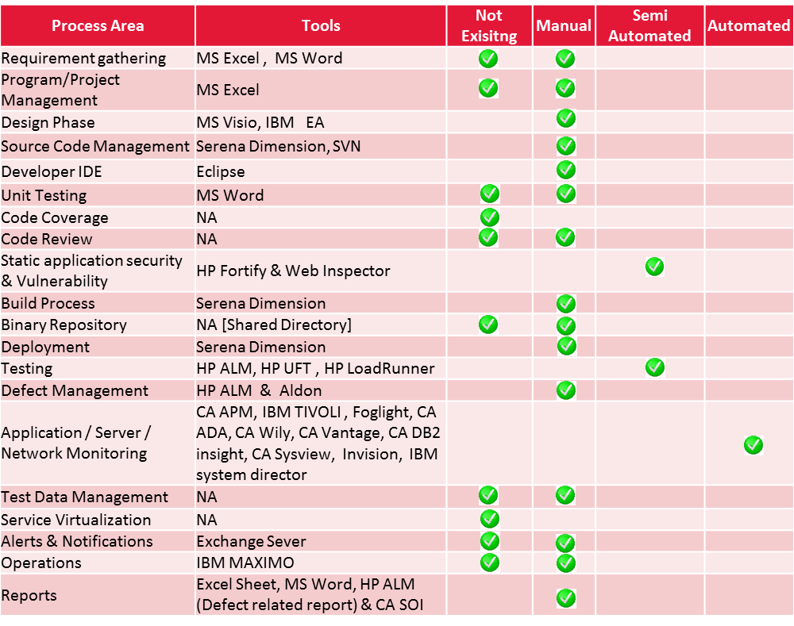
Current State: High-level Overview – Application SEL
Project type: Scotia En Linea, Technology: Java 1.6, JSP ,Data Base: DB2 10.5, Domain: Channel’s ,Environments: Dev, QAT, Production
Application Type: Web ,WAS 7.0 in AIX 6.1 and Tuxedo 8.1 Operative System
Key Observations:
The development process follows waterfall model. Test preparation runs in parallel with development.
The SEL’s team avoid parallel development to avoid performing the merge.
Merge is manually performed.
The code versions used to promote to non-production and production environments are maintained in Serena Dimensions as a part of waterfall process.
Non-integrated source control tool usage. Although there is a tool for versions control, this is not implemented so that developers use it day by day.
The management of the UAT environment and all non-production environments in day to day projects are made by SEL’s development team.
Code revisions are manually performed.
Unit testing are performed manually.
Before releasing, SEL’s development team requests the production version, and requests again the version because in the meanwhile the Solution Factory might have changed something.
In case of defects in unitary tests, the follow-up is by mail.
The build process manually performed .
Production version is build manually by SEL’s development team.
The deployment process manually performed.

Slide 39
Transformation Initiative Defined
Initiatives | Initiative Overview | Expected Outcome
Continuous Planning | Review and sign off from the customer on regular basis Implement JIRA & CONFLUENCE platform; sprint and release planning Capture the requirements in the pre-defined templates (Epics, stories and Tasks) Team Collaboration & Documents Repository Link test cases & defects to the requirements | Collaboration between the team is established Reduce the reworks and defect seepage Custom reports and dashboards providing higher visibility
Continuous Integration | Develop plugins to integrate multiple tools Process automation for source code management, unit testing, build and code reviews. Jenkins to orchestrate the processes Restructure the Source Code repository [Brach Structure]. Pipeline to Move Valid code from Sub branch to branch Automated Code Review to Move the Valid code into Main Branch. Implement the Continuous Integration pipeline Automated static application security testing & Vulnerability Testing | Minimize/eliminate code merger issues and improves Code quality Traceability of requirements to build and test phases Cycle time improvements and quality
Continuous Testing | Define and implement test automation (functional and non-functional) Identify and agree critical test cases and document them Standardize test data management process Map test cases and defects to requirements Track defects in standardized defect management tool like HP ALM Implement the Agile planning Implement the Test Data Management Implement the Service Virtualization | Improves the test case quality Automations increases the execution efficiency Automatic Testing Dashboard & Reports
Continuous Delivery | Release and deployment automation in all managed environments Automate rollback deployment Automated Environment Provisioning & Configuration Management Build the E2E DevOps platform with Change management , Application support & Monitoring | Reduces manual efforts Easy to monitors releases Generates reports and dashboards Reduces deployment failures
Dashboards & Reports | Customizing & designing different reports & dashboards : Code Quality check dashboard & report Releases and Deployment dashboard Test report Notification report Customizable Reports as per the Roles defined | Establishes end to end traceability and visibility Enable the Collaborations

Slide 40
Key Process Areas for Continuous Delivery
Business Alignment
Release
Planning
Infrastructure & Resource Planning
Agile Delivery Planning
Task Planning
Traceability & Feedback
CONTINUOUS
PLANNING
Configuration Management
Work Item Management
Build and Dependency Management
Repository Management
Code review and Analysis
Unit Testing & Test Automation
Traceability & Feedback
CONTINUOUS
INTEGRATION
Test Planning & Management
Test Asset Management
Test Automation (Fun & NFR)
Test Environment
Test Virtualization for Stubbing
Defect Management
Traceability & Feedback
CONTINUOUS
TESTING
Environment Configuration (Infrastructure as code)
Environment Provisioning
Release Planning and Orchestration
Deployment Strategies and Automation
Policies and
security
Workflow
Automation
Traceability & Feedback
RELEASE AND
DEPLOYMENT
Monitoring & Support process for projects
Training & Enablement
KPIs & Metrics
Project On-Boarding Process
Roles and Responsibilities
Communication & Change Management.
Governance
SUPPORTING
PROCESSES
Automation of each process will bring the DevOps Maturity

Slide 41
Transformation Initiative
Agile + DevOps Transformation
Implement JIRA for Requirement Gathering & planning
Implement CONFLUENCE for Collaboration & Document Repo.
Release and Deployment Automation for Pre Prod
Continuous Integration
Automated Environment provisioning
DevOps Platform
Artifacts Migration
Continuous Testing , Service Virtualization and Test Data Management
Release and Deployment Automation for Production
Training
Customized Reports & Dashboard
DevOps Platform Support & Services

Slide 42
Recommendation on the roadmap will be based on..
Applications Categorization
Transformation Approach
Process Maturity
Organizational Challenges
Identify the most Critical Applications
Phase wise approach
Process does not exist/Adhoc
Process exists and partially automated
Complex process
Process are integrated but manual hand offs
Automated and integrated processes
Organizational Barriers
Customer centricity
Team Size
Identify the most frequent changes applications
Based on the Customer Prioritization
Based on the applications Technologies
Based on the Business unit Prioritization
Build the DevOps Services Point Solutions with 3 customer identified applications
Build the E2E platform with required DevOps Services
Provide the E2E platform service

Slide 43

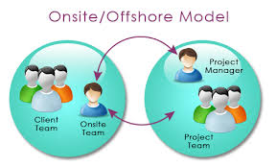
Enabling Process Guided end-end DevOps platform build, on boarding & adoption
1. Conduct Assessment Session with Project Team
2. Presents Assessment Outcome findings To Project Team
Is it
Fit for Adoption?
Yes
DevOps
Pipeline
No
DevOps Platform
Architect/
Evangelist
4. Follow-Up with Project Team and Conduct Re-Assessment of Application
7. Get Consensus
on transition plan with project Team
3. Discuss Remediation Plan with Project Team
6. Review
The transition Plan
1. Work out transition plan
DevOps
Pipeline
Onsite –Offshore based
DevOps Platform Team
2. Kick-off transition meetings with project teams
3. Execute post On boarding activities
4. Train the Project Team
5. Start the support services

Slide 44



Implementation Approach: DevOps CoE
Scotia - TechM DevOps COE
Continuous Planning
CI and Build Management
Continuous Testing & SV
Release and deployment Automation
Continuous Monitoring and Feedback
Platform
Support
Process & Engineering
DevOps
Consulting
DevOps Training
DevOps Lab
Software Installation & configuration support
Tools Alliance
Tools Evaluation
POC engine
Tool and Process Training
Platform Administration
Application Maturity Assessment
Governance and reporting
Best Practices
Knowledge Management
Resource Management
Platform Onboarding
Automation Implementation
>
DevOps
COE
>
Communications
Governance
Application
Onboarding
Technical Support & Assurance
>
Certifications & Staffing
Operational Metrics
Project Management Office (PMO)
Innovation and Collaboration
Coaches and SMEs
Standardize
Centralize
Optimize
Review
Expand & Sustain

Slide 45
Thank you
Visit us at www.techmahindra.com

